Slide 1


SOCIAL BOOKS GROUP 10
By
Awais Akbar (19251600)
Karthick Pandi (19250898)
Yang Wang

Slide 2
TECHNOLOGIES USED

Slide 3
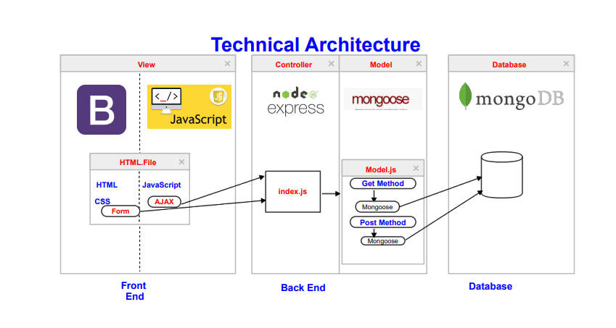

Slide 4
Model - View - Controller
Model : Mongoose
- Managing Relationship between data.
- Schema Validation
- Object representation in MongoDB.

Slide 5
Model - View - Controller
View : HTML, CSS, Boot Strap
- HTML & CSS : Page designing and styling
- Bootstrap : Framework

Slide 6
Model - View - Controller
Controller : JavaScript , Express
- JavaScript : Implementing functions.
- Express : API Creation

Slide 7
ARCHITECURE DIAGRAM

Slide 8
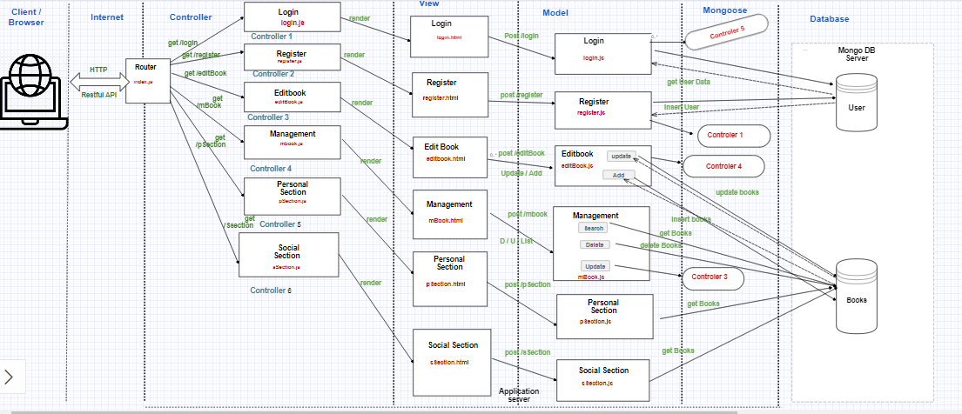

Slide 9
REQUIREMENTS
1) User Sign In and adding books:
Functions : login() - Logging into the application.
register() – Registering new user
create() - Adding a book into library
edit() - Editing the book details
delete() - deleting the books

Slide 10
REQUIREMENTS
2) - Forming topics based on metadata tags
- Searching based on that topics.
3) Books Recommendation

Slide 11
PERSONAL SECTION
Personal Section :
1) This section holds the list of books available in personal section
2) In addition to that it has customized search where we can able to search the books based on topics.

Slide 12
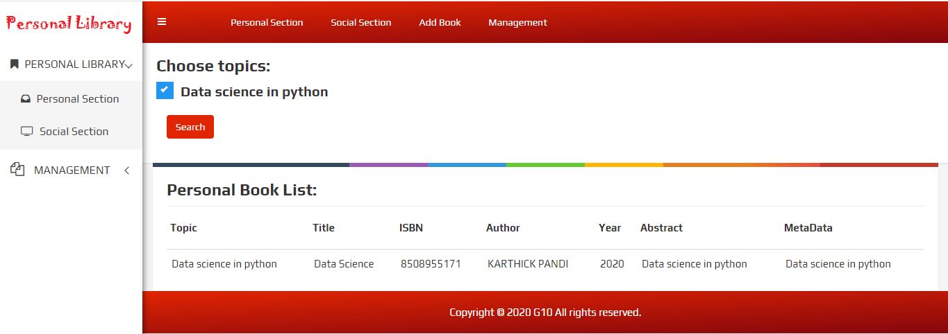
PERSONAL SECTION

Slide 13
SOCIAL SECTION
Social Section :
1) This section holds the list of books available in social section
2) In addition to that it has customized search where we can able to search the books based on topics.

Slide 14
SOCIAL SECTION
Social Section :
3) Book Recommendation:
User can able to view other user books if they share atleast three books in common.

Slide 15
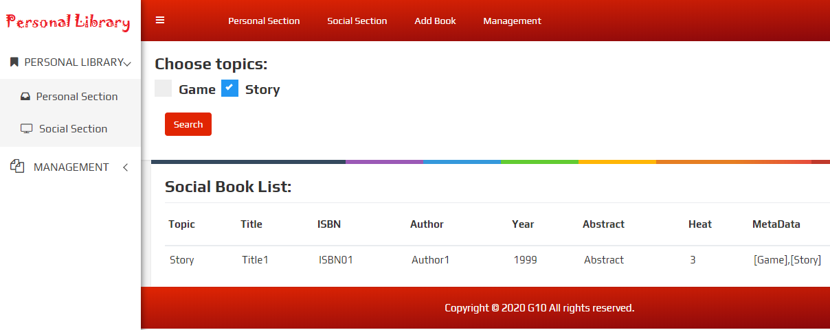
SOCIAL SECTION

Slide 16
ADD BOOK
Add Book :
1) Here we can add books to this library .The fields which required to add the books includes:
Title
Author
Public Year
ISBN
Abstract
Metadata

Slide 17
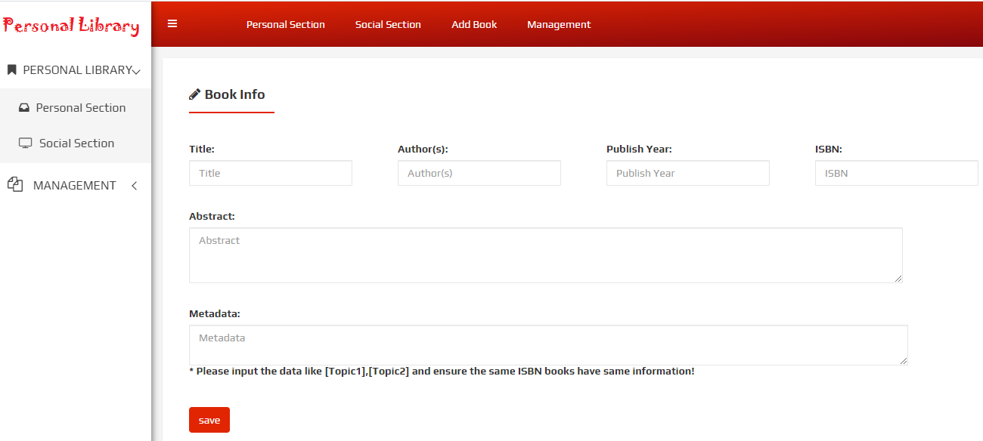
ADD BOOK

Slide 18
BOOK MANAGEMENT
Book Management :
1) Customized search based on Title, Author Name, Published Year and ISBN.

Slide 19
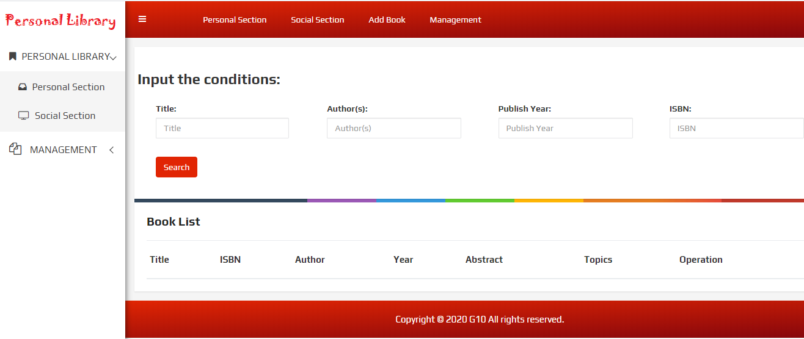
BOOK MANAGEMENT

Slide 20

WEB HOSTING

Slide 21
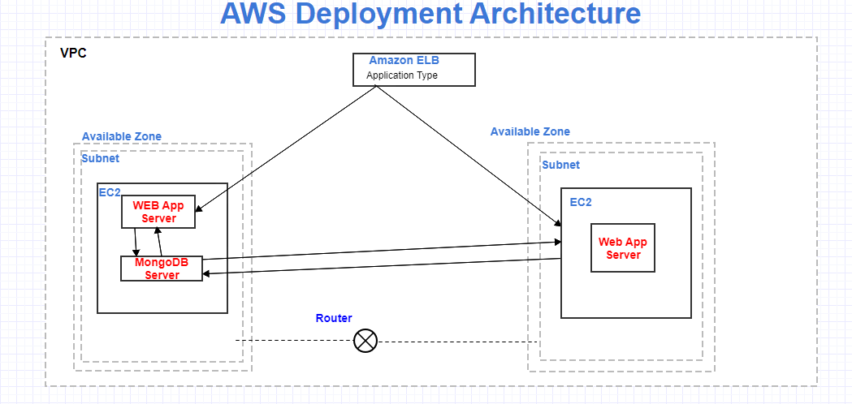
APP DEPLOYMENT

Slide 22
APP DEPLOYMENT
AMAZON ELB ( Elastic Load Balancing ) :
For Consistence Application Performance
EC2 : Virtual Server
Available Zone: Data Centre

Slide 23
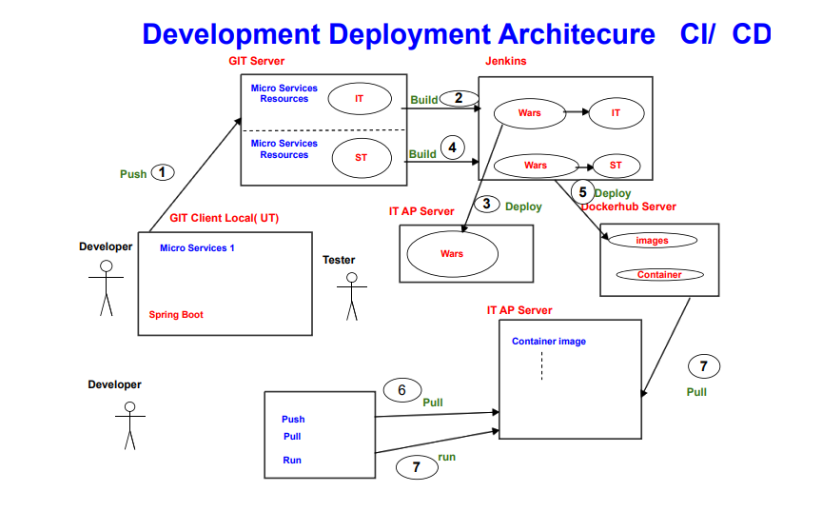

Slide 24


